Slide 1
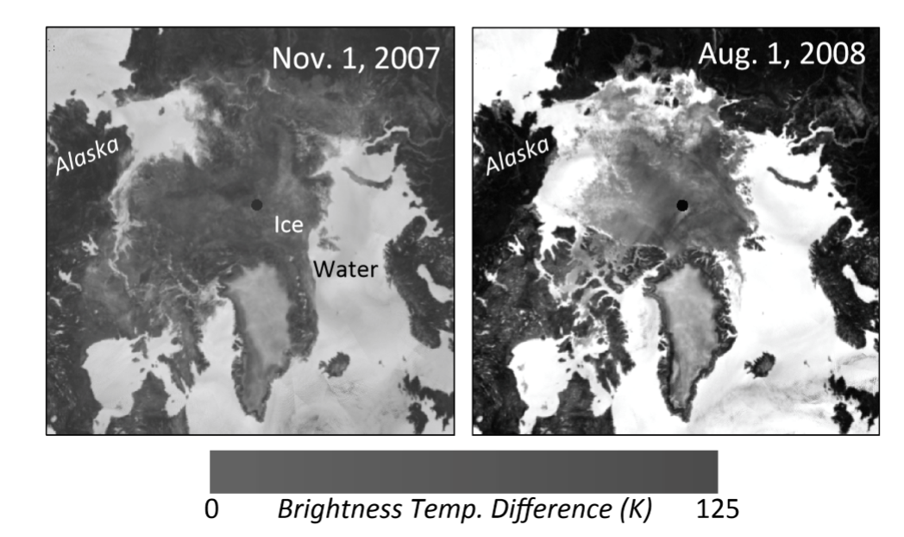
Sea Ice Concentration Retrieval and Data Assimilation
Ty ,Siyang and Christian

Slide 3
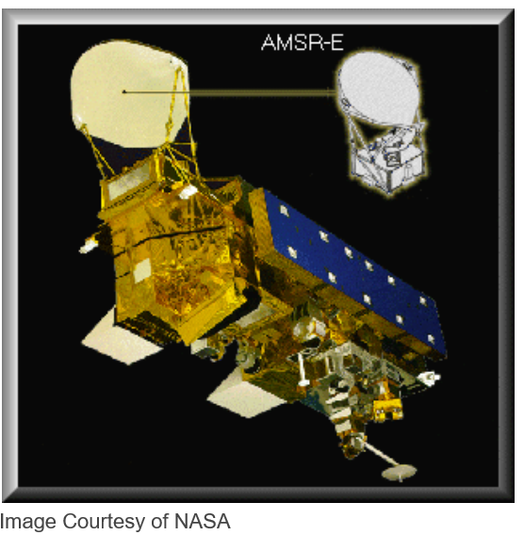
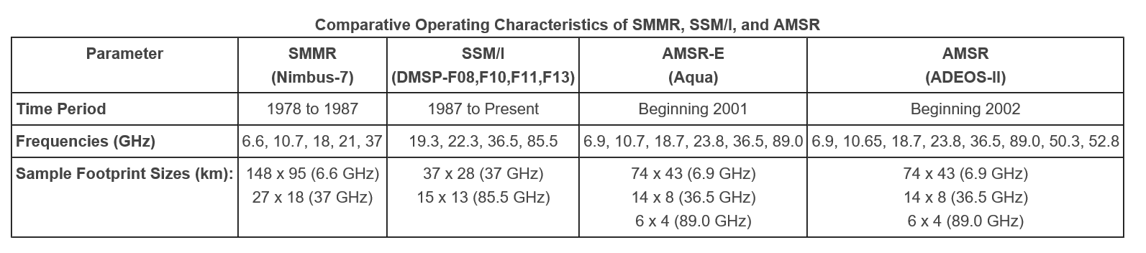
Passive Microwave
The polar regions are typically cloudy restricting continuous sea ice observations in the visible spectrum.
Microwaves pass right through the clouds and microwave radiometry can provide continuous daily observations of sea ice concentration.
However, they are typically low resolution ~14-25km.
There is an over 30 year daily record of sea ice concentration.

Slide 4
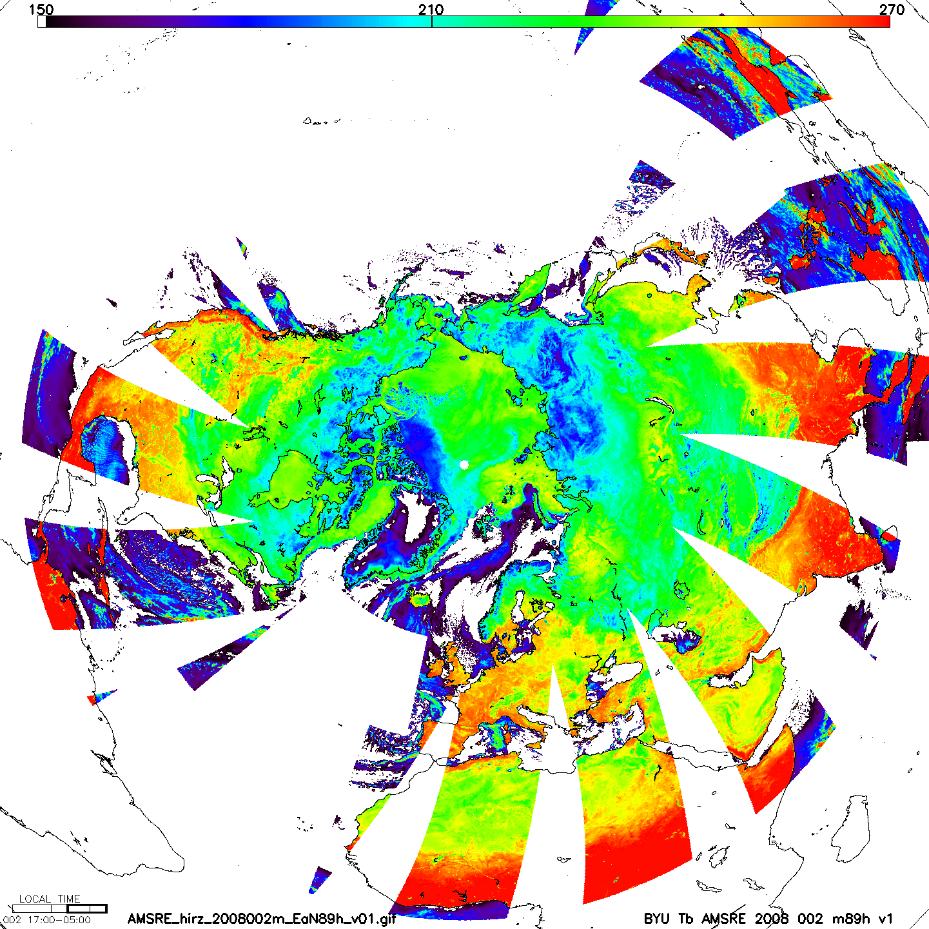
Brightness Temperature

Slide 5
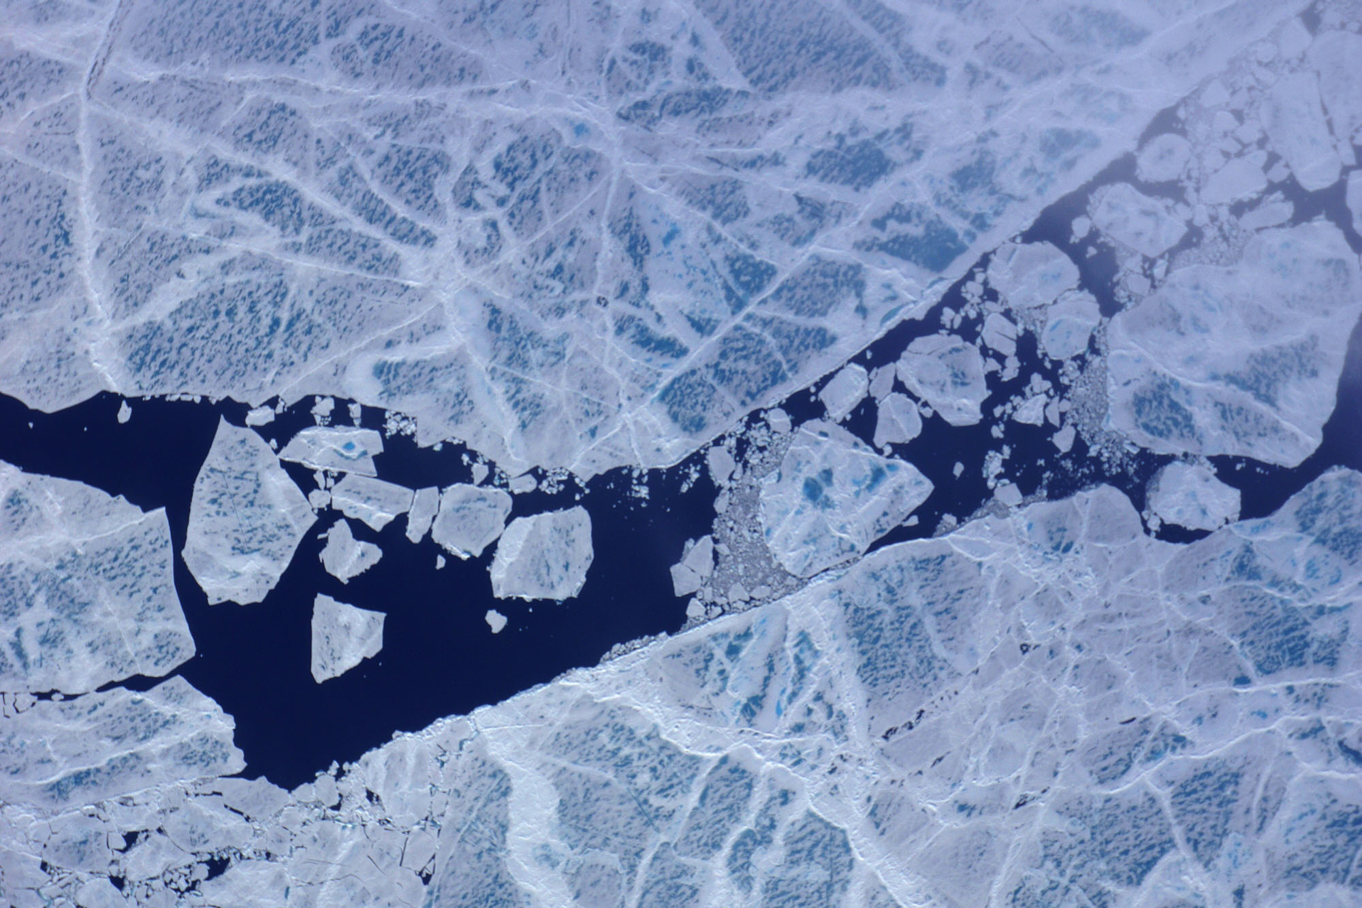
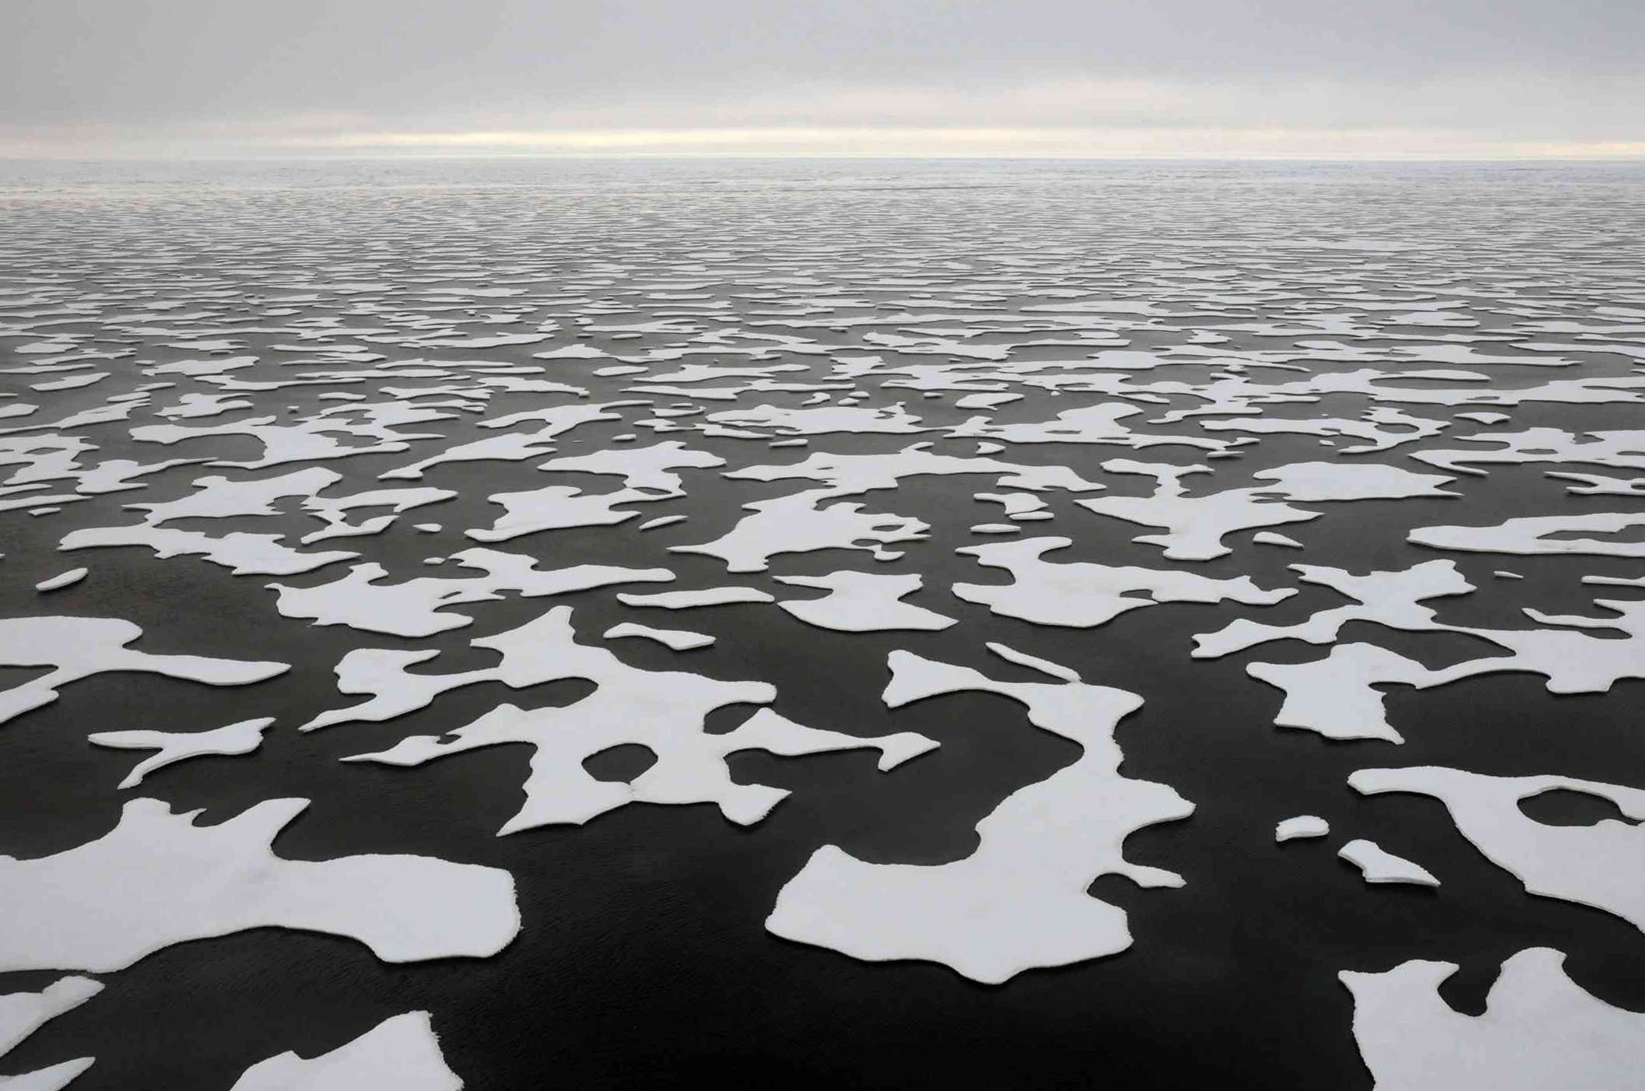
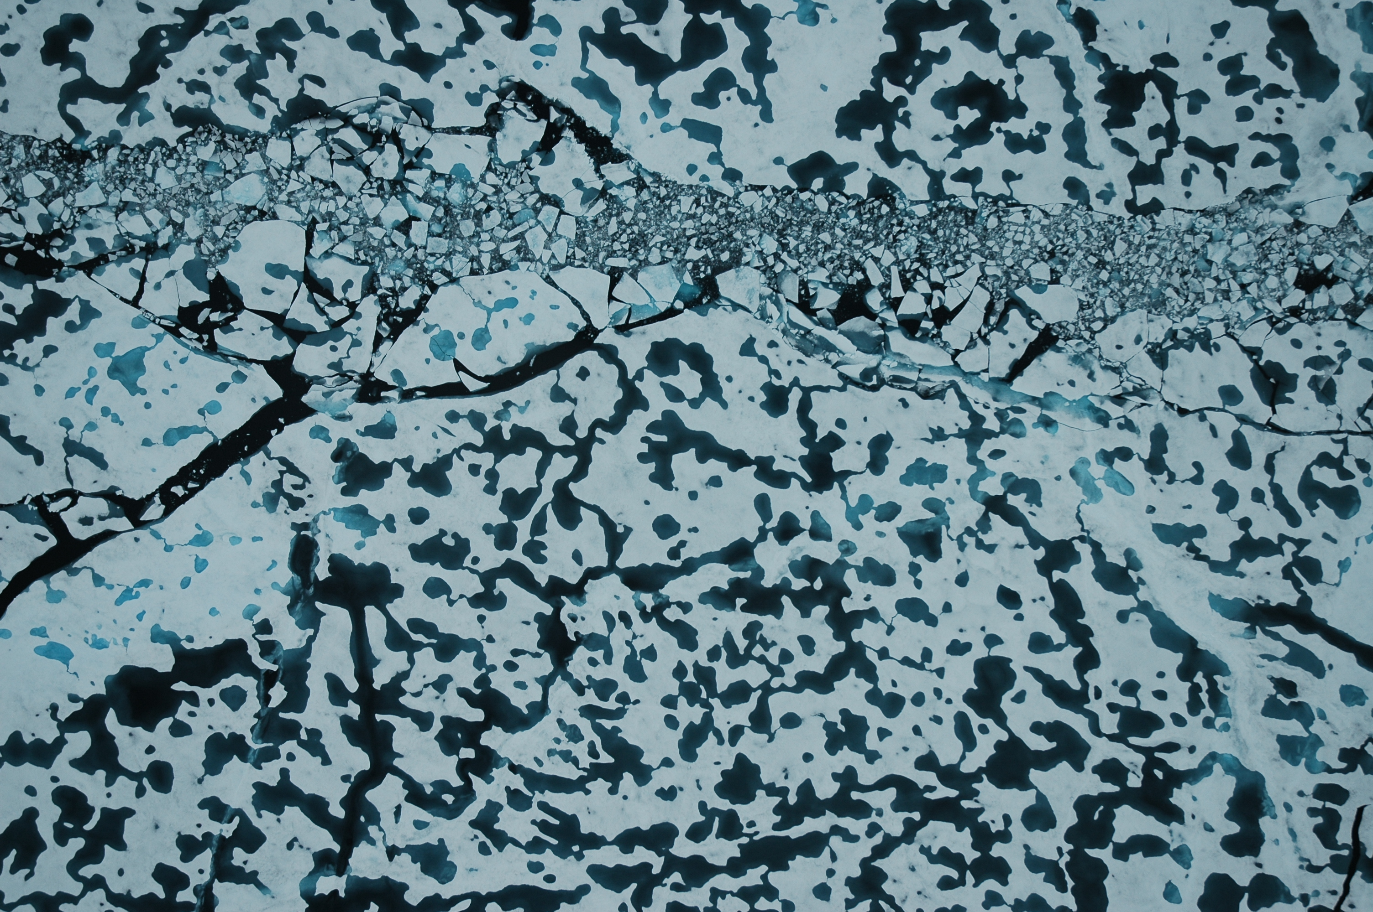
Melt ponds!

Slide 6
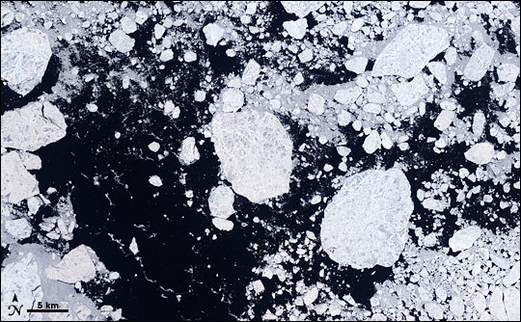
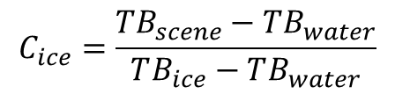
Basically…
A combination of the ponds and water
$$C_{ice}=\frac{TB_{scene}−TB_{water}}{TB_{ice}−TB_{water}}$$

Slide 7
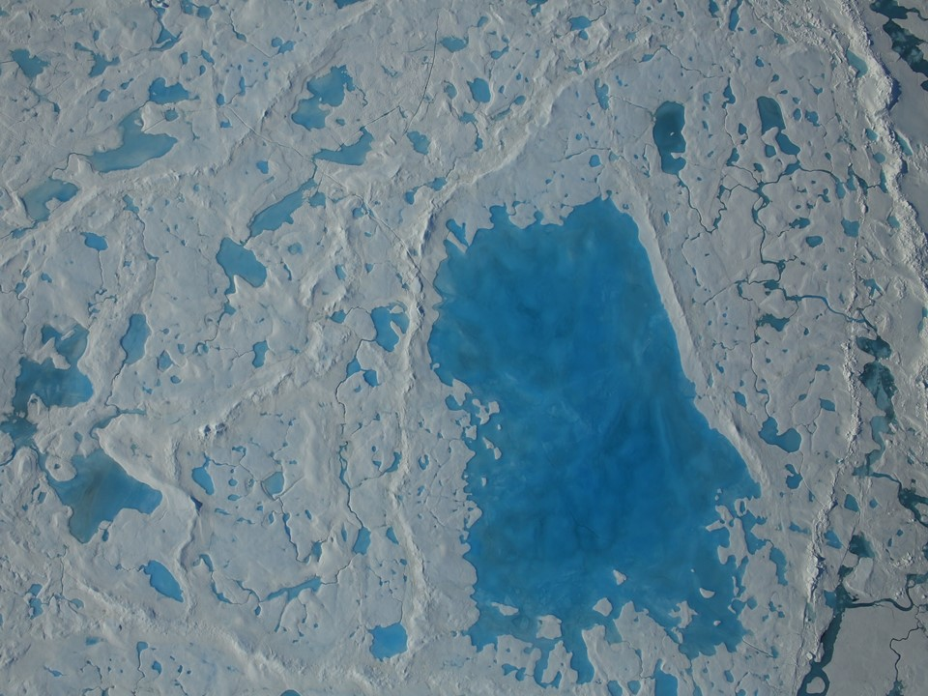
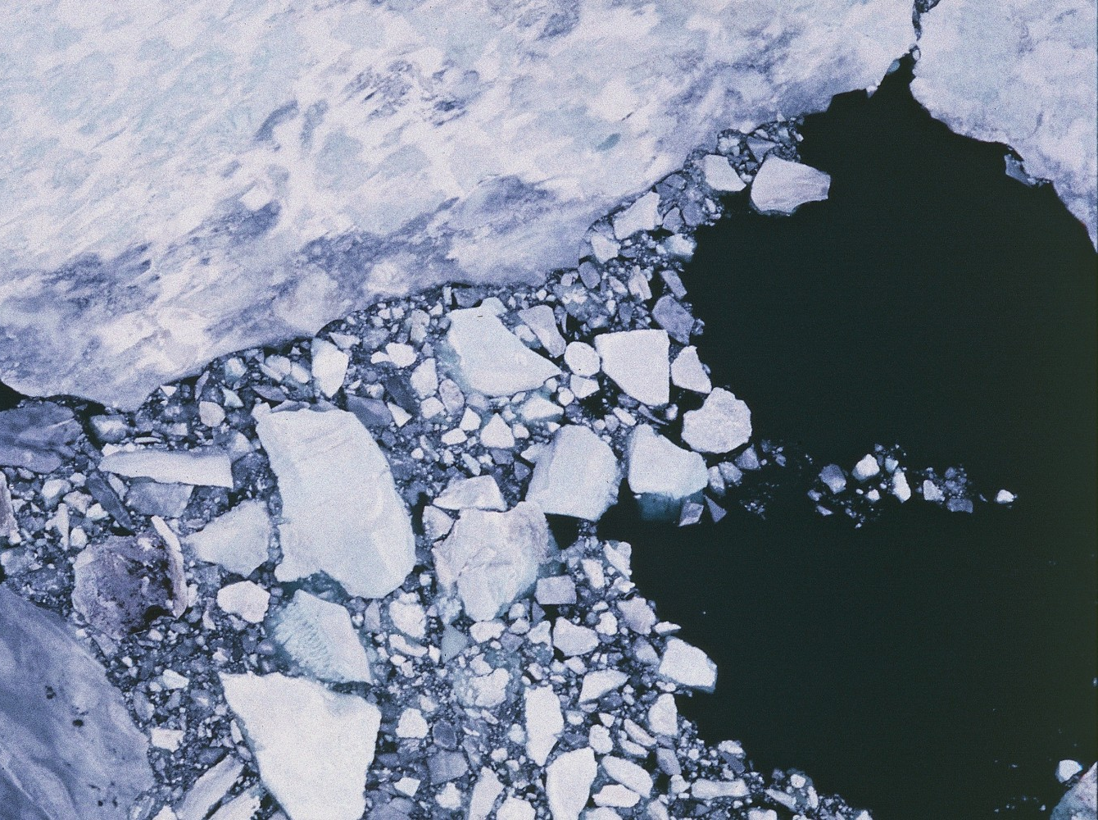
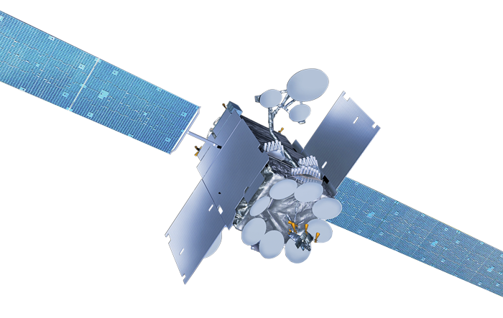
Concentration:
Open Water: 0%
Ice: 100%
Melt Ponds: 40%
Concentration:
Open Water: 40%
Ice: 60%
Melt Ponds: 0%
Open Water
Melt Ponds
?
Retrieval Algorithm
Same Radiance!

Slide 8
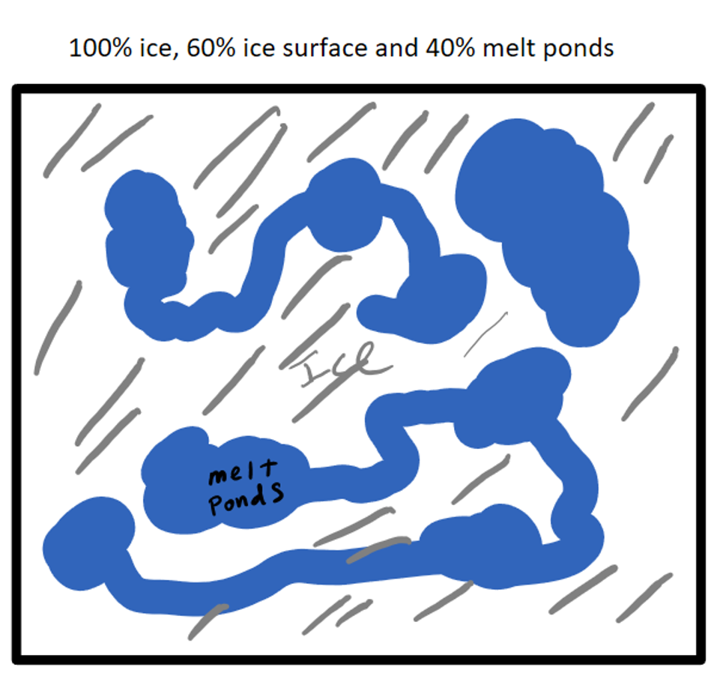
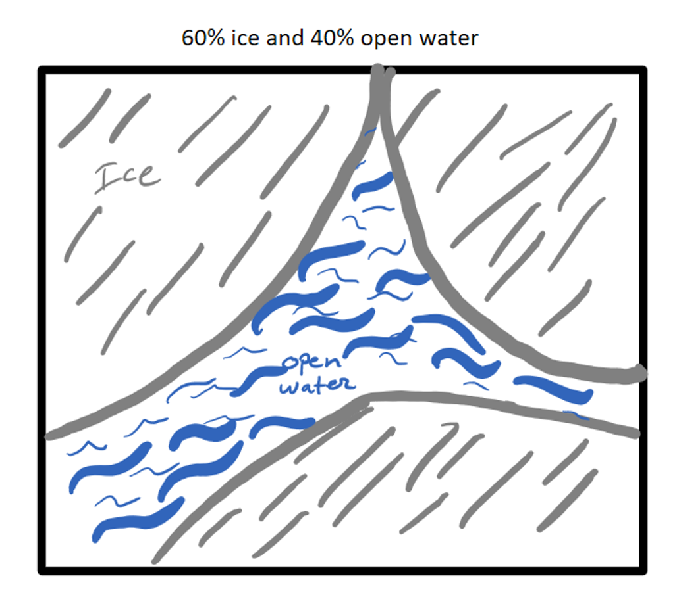
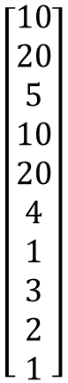
Both of these situations look the same to the satellite
An inversion algorithm from the radiances to ice concentration will likely be wrong
If you are assimilating an ice concentration you would not want to assimilate 60% ice when your model and reality say it is 100% ice.
$$\left[\begin{aligned}10 \\ 20 \\ 5 \\ 10 \\ 20 \\ 4 \\ 1 \\ 3 \\ 2 \\ 1\end{aligned}\right]$$

Slide 9
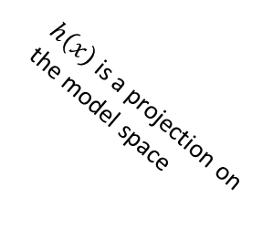
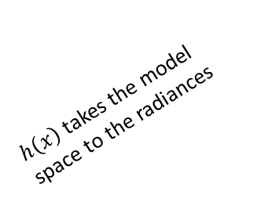


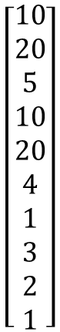

$$\left[\begin{aligned}10 \\ 20 \\ 5 \\ 10 \\ 20 \\ 4 \\ 1 \\ 3 \\ 2 \\ 1\end{aligned}\right]$$
$h\left(x\right)$takes the model space to the radiances
Direct radiance
observation
Analysis
Model
Truth
Wrong inverse
observation
$h\left(x\right)$ is a projection on the model space
Analysis

Slide 10
Problem Review
Melt ponds have the same microwave signature as open water and obscure the signature of the ice below them. Interfering with concentration retrievals.
As a result summertime sea ice concentration values can be very wrong, the inversion from satellite radiances to concentration is extremely difficult
We want to investigate observation operators that take the sea ice state to the satellite radiances to avoid the issues with this inversion. We want to use machine learning to “discover” this observation operator. We will use the instances where we have optical images and microwave radiance values for the same location in space and time as our training set.

Slide 11
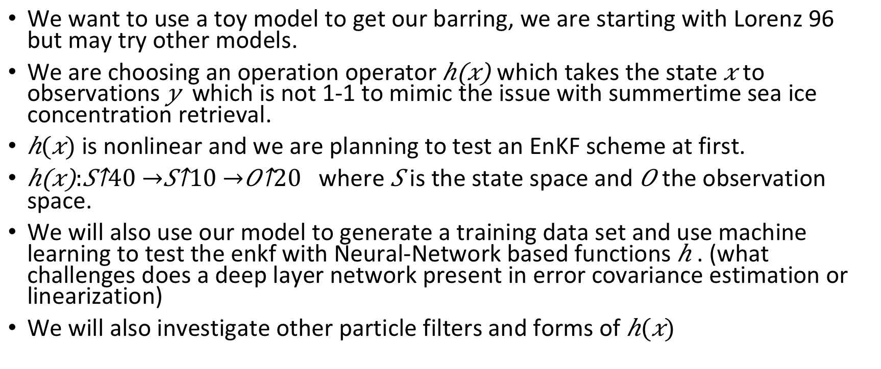
Start with a toy model
We want to use a toy model to get our barring, we are starting with Lorenz 96 but may try other models.
We are choosing an operation operator which takes the state to observations which is not 1-1 to mimic the issue with summertime sea ice concentration retrieval.
is nonlinear and we are planning to test an EnKF scheme at first.
where is the state space and the observation space.
We will also use our model to generate a training data set and use machine learning to test the enkf with Neural-Network based functions . (what challenges does a deep layer network present in error covariance estimation or linearization)
We will also investigate other particle filters and forms of

Slide 12
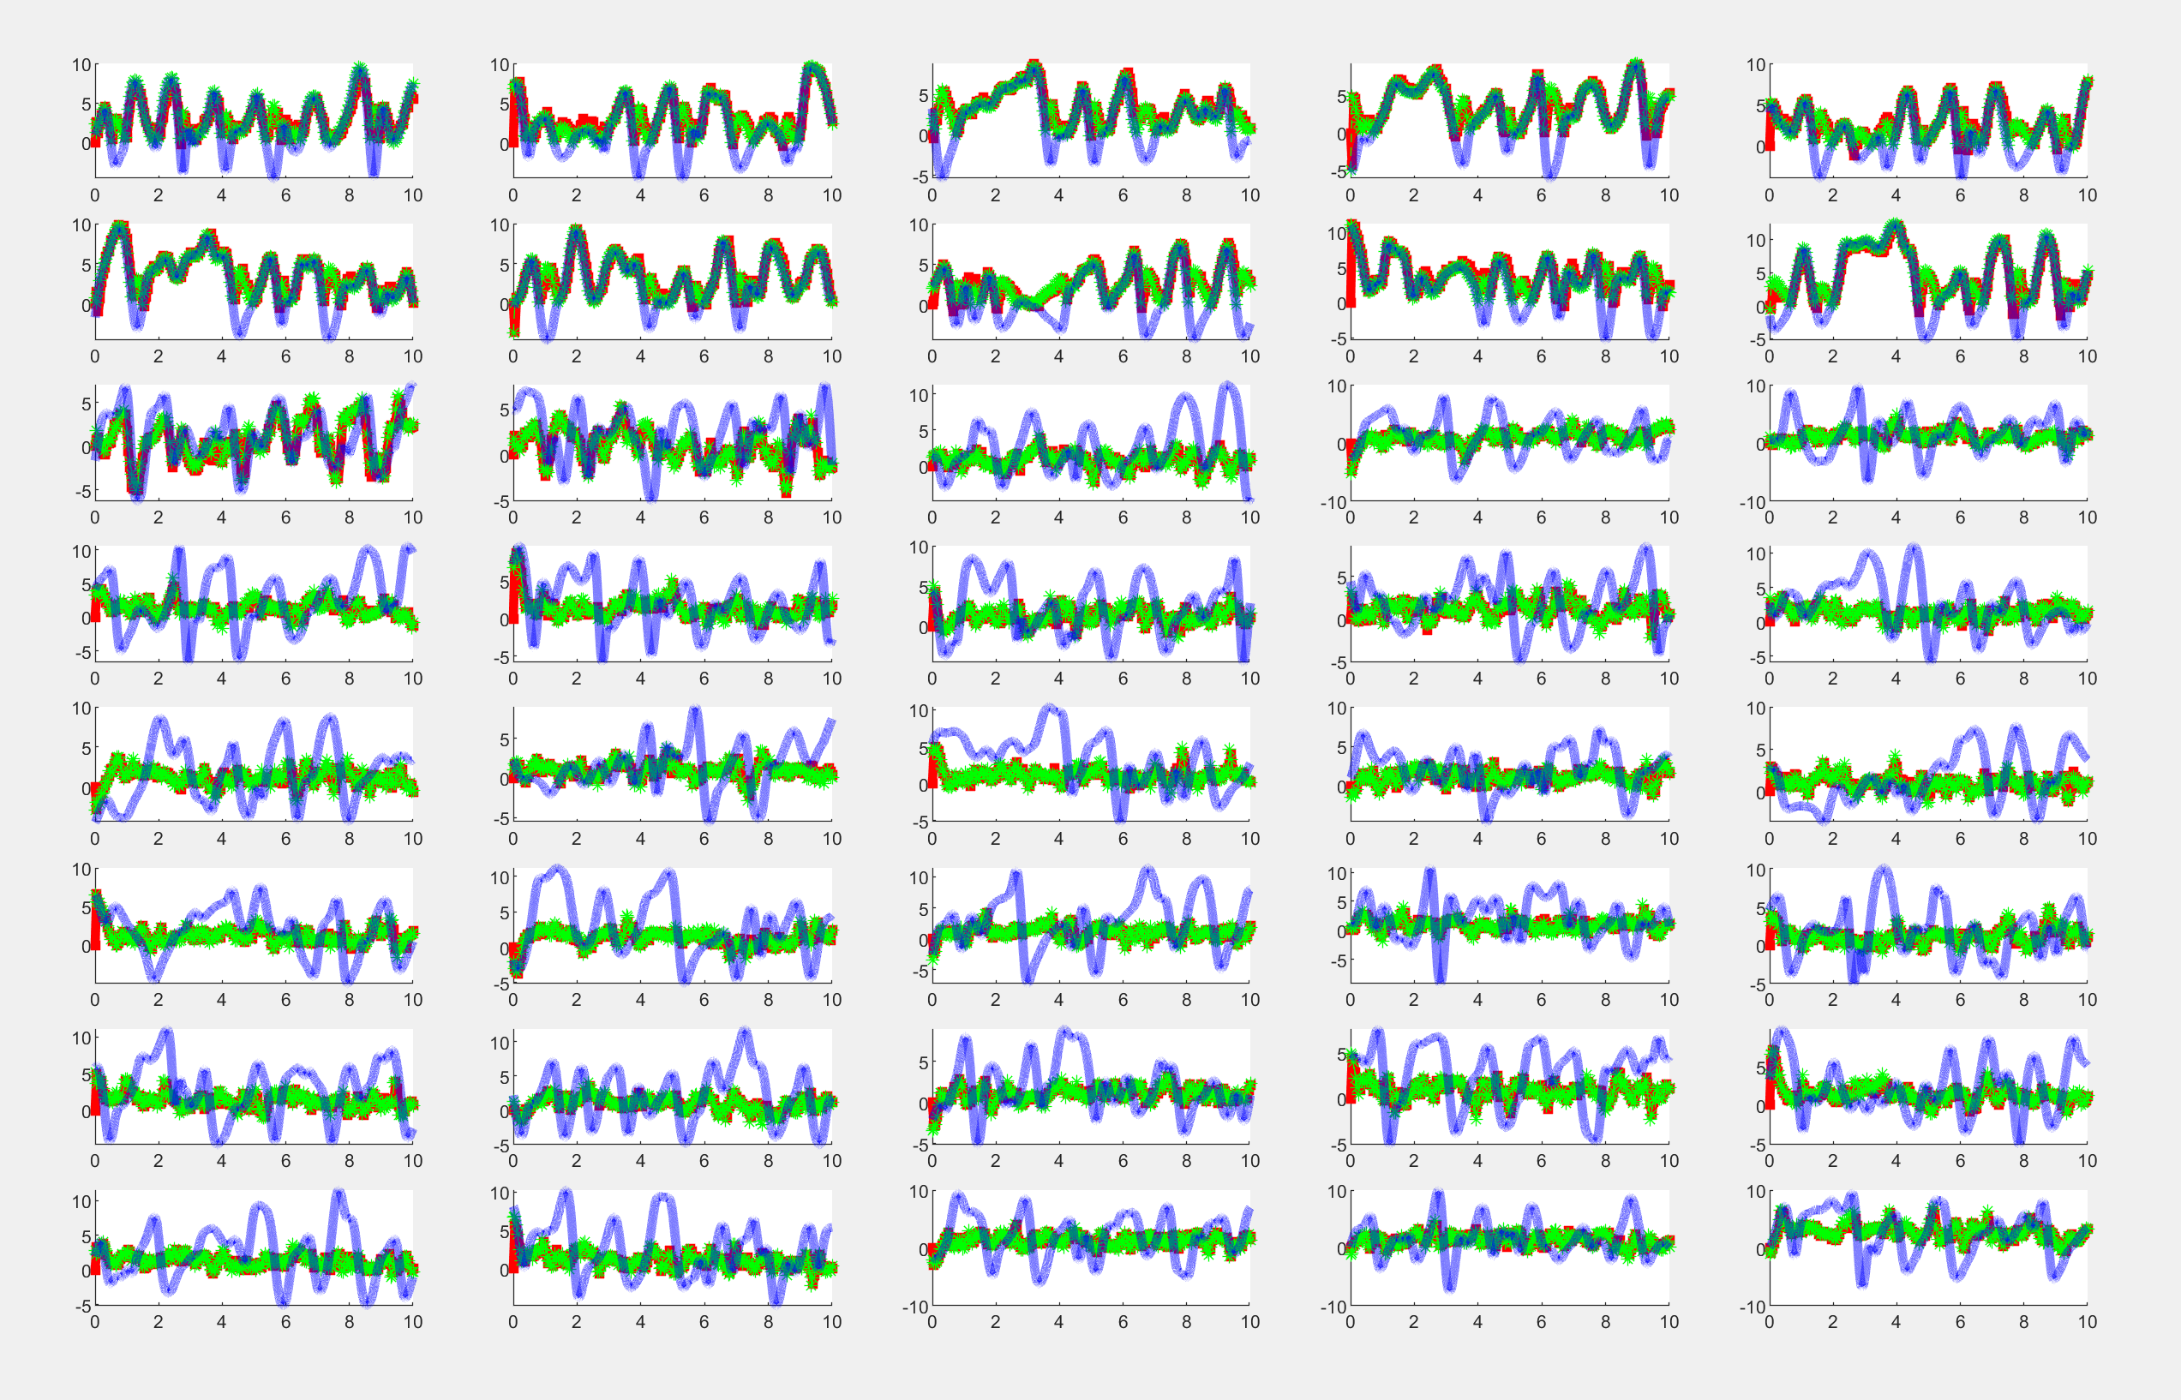
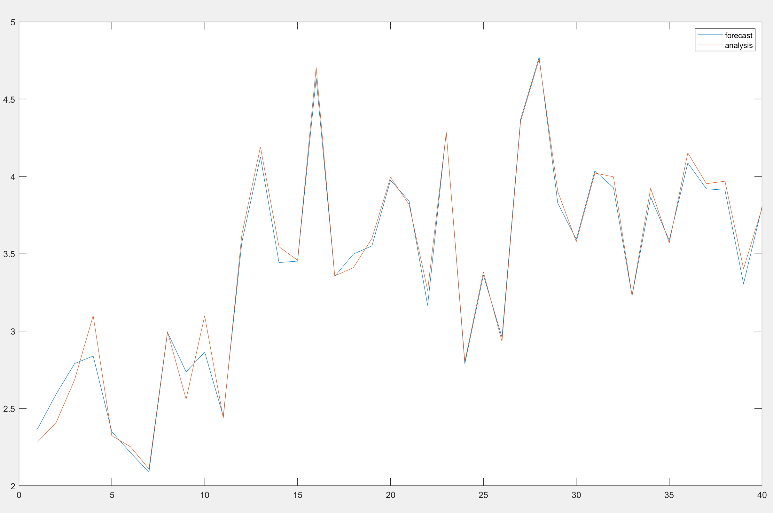
Lorenz 96 using the inverted state space

Slide 13
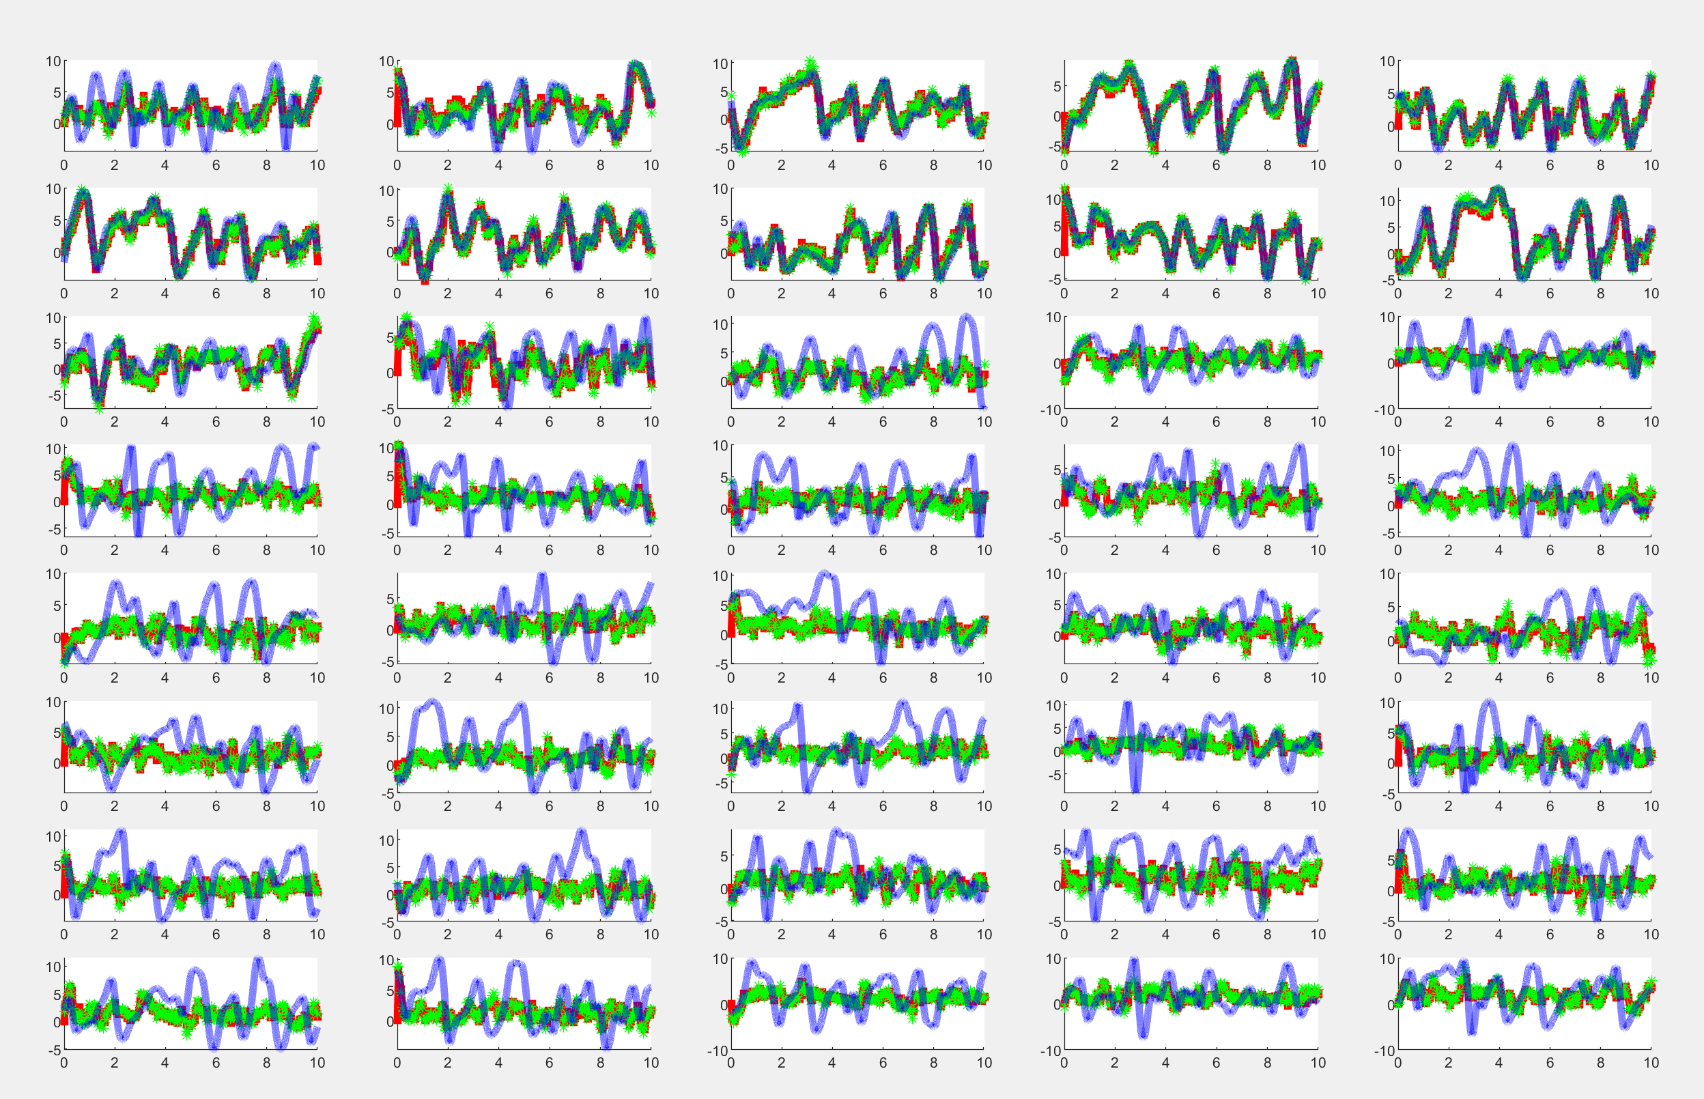
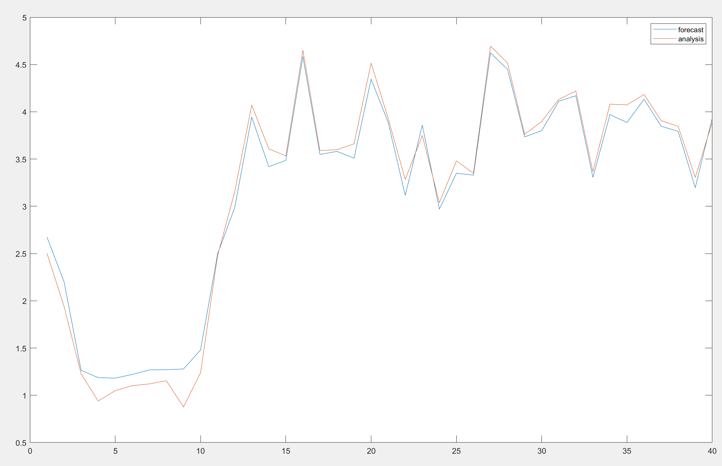
Lorenz 96 using the known observation operator

Slide 14
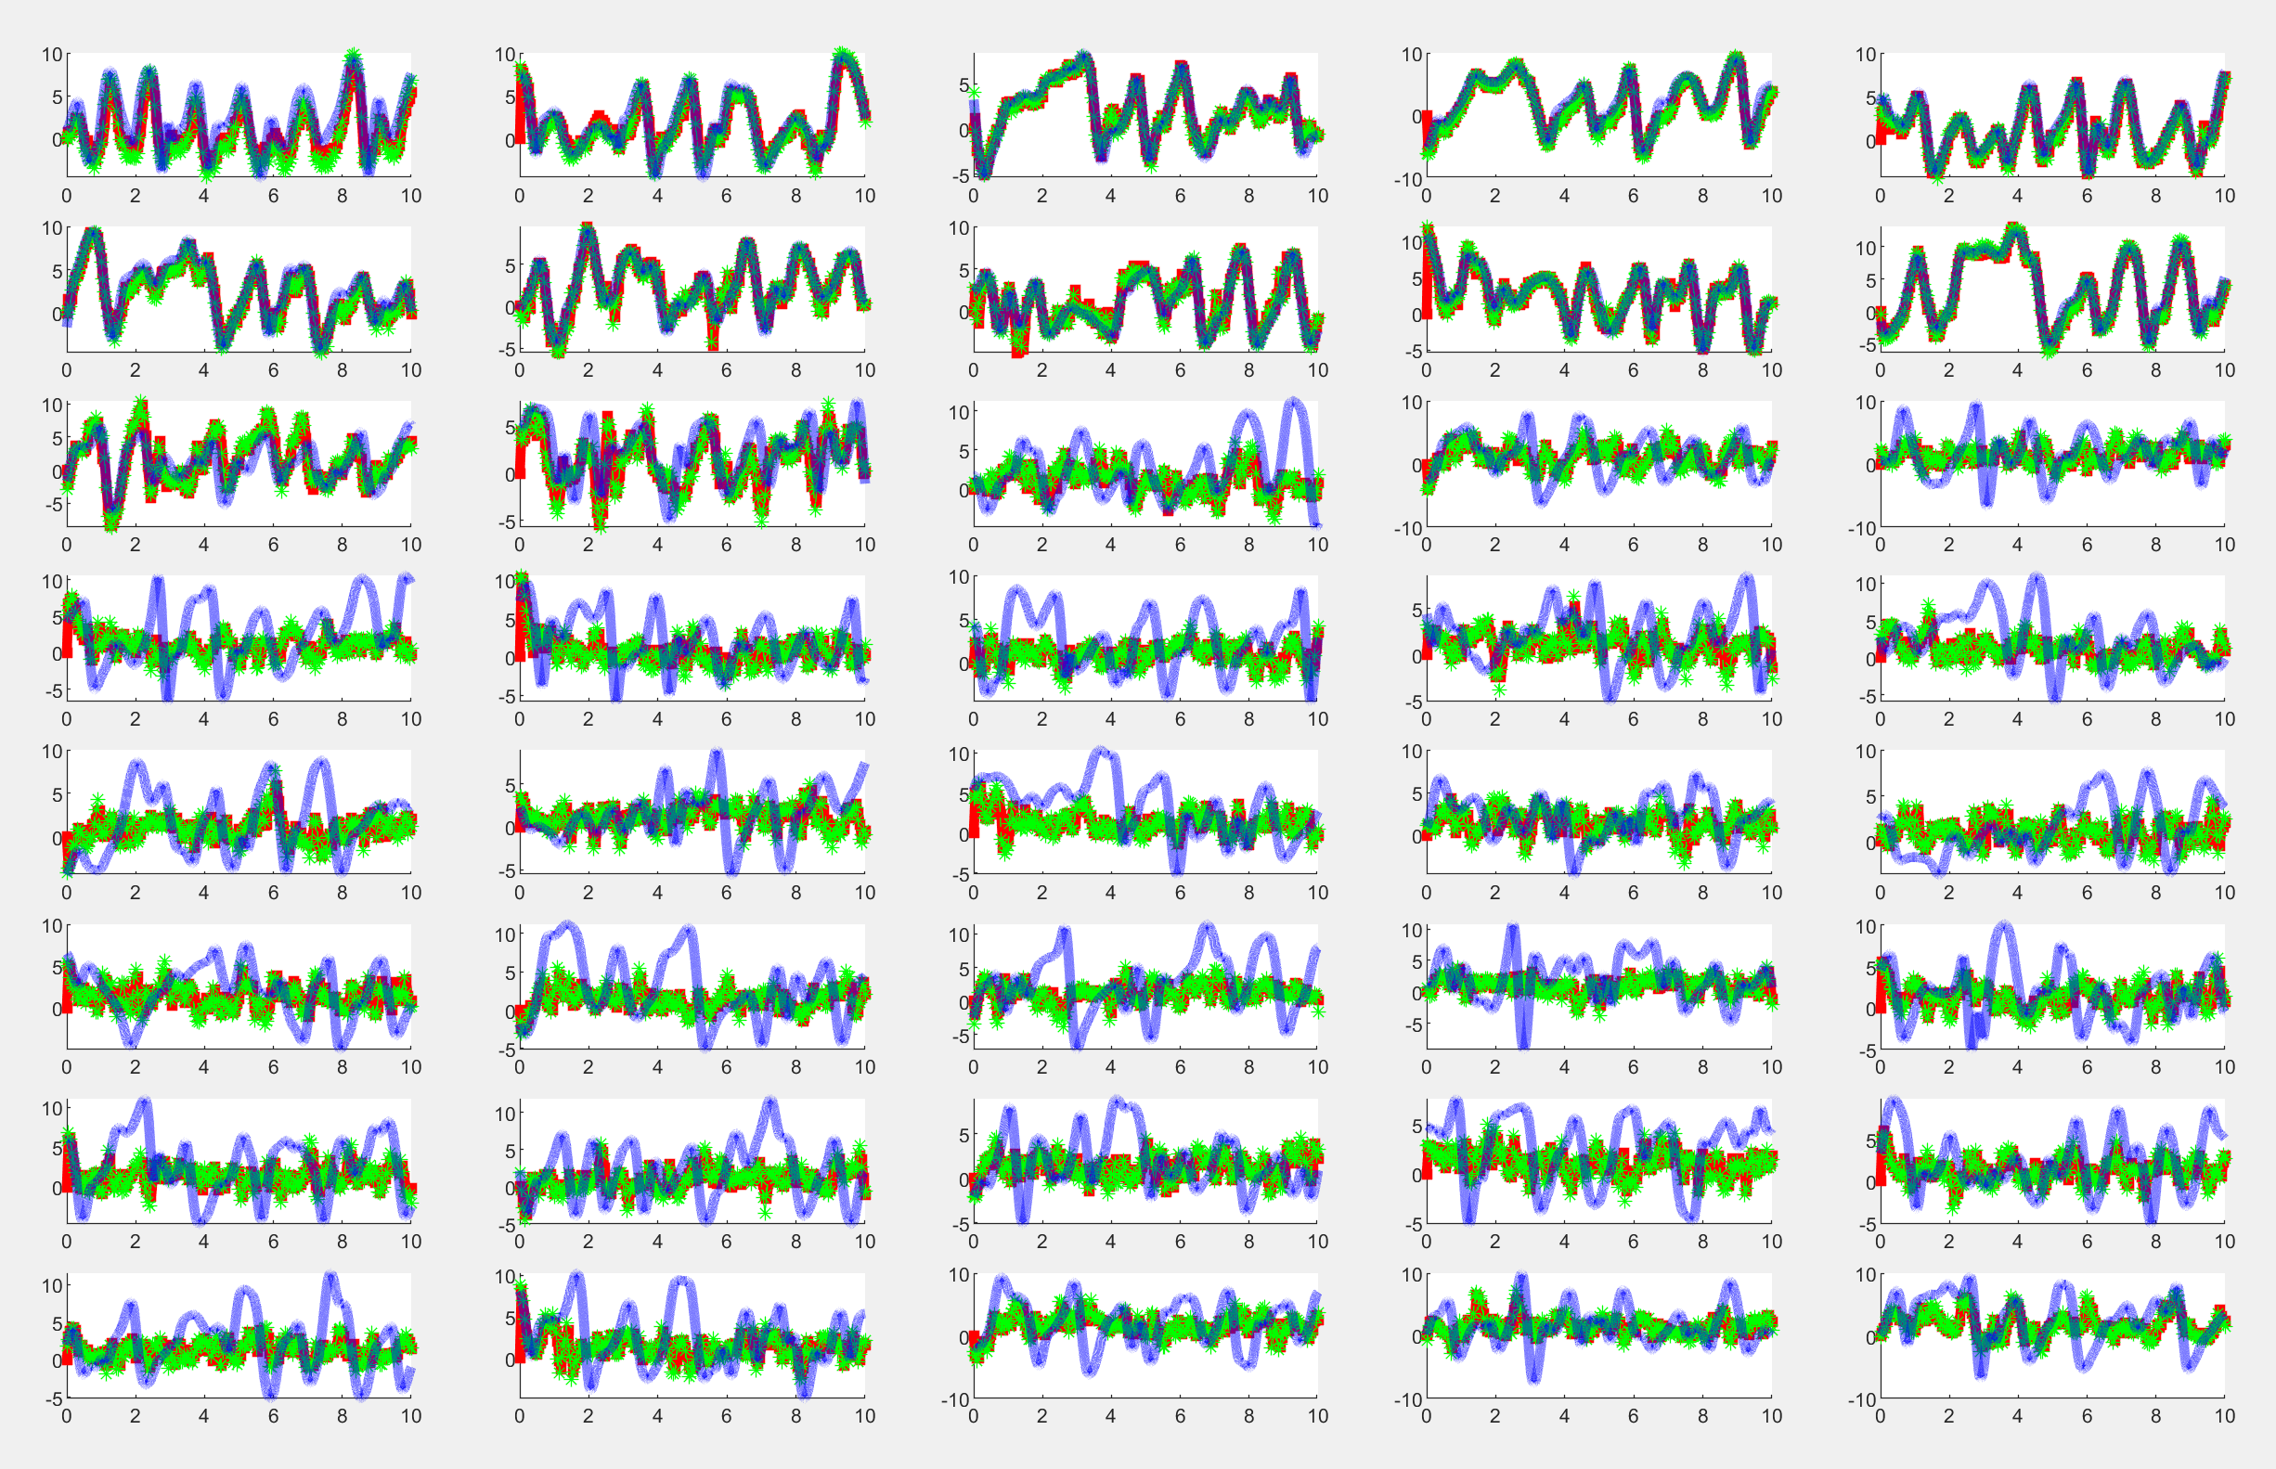
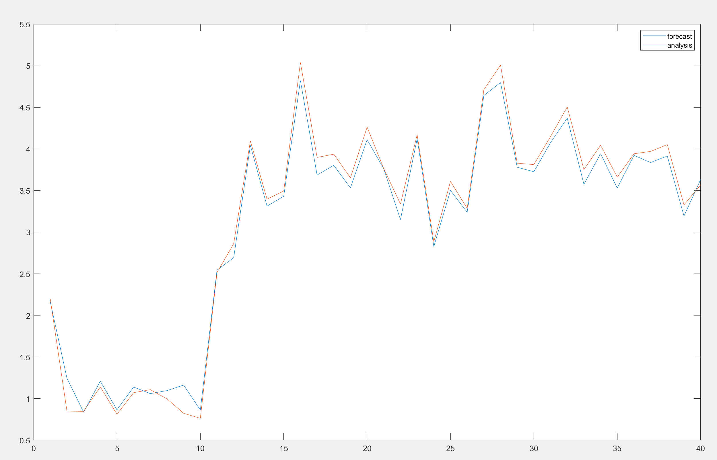
Lorenz 96 using the machine learned observation operator on the first 10 variables

Slide 15
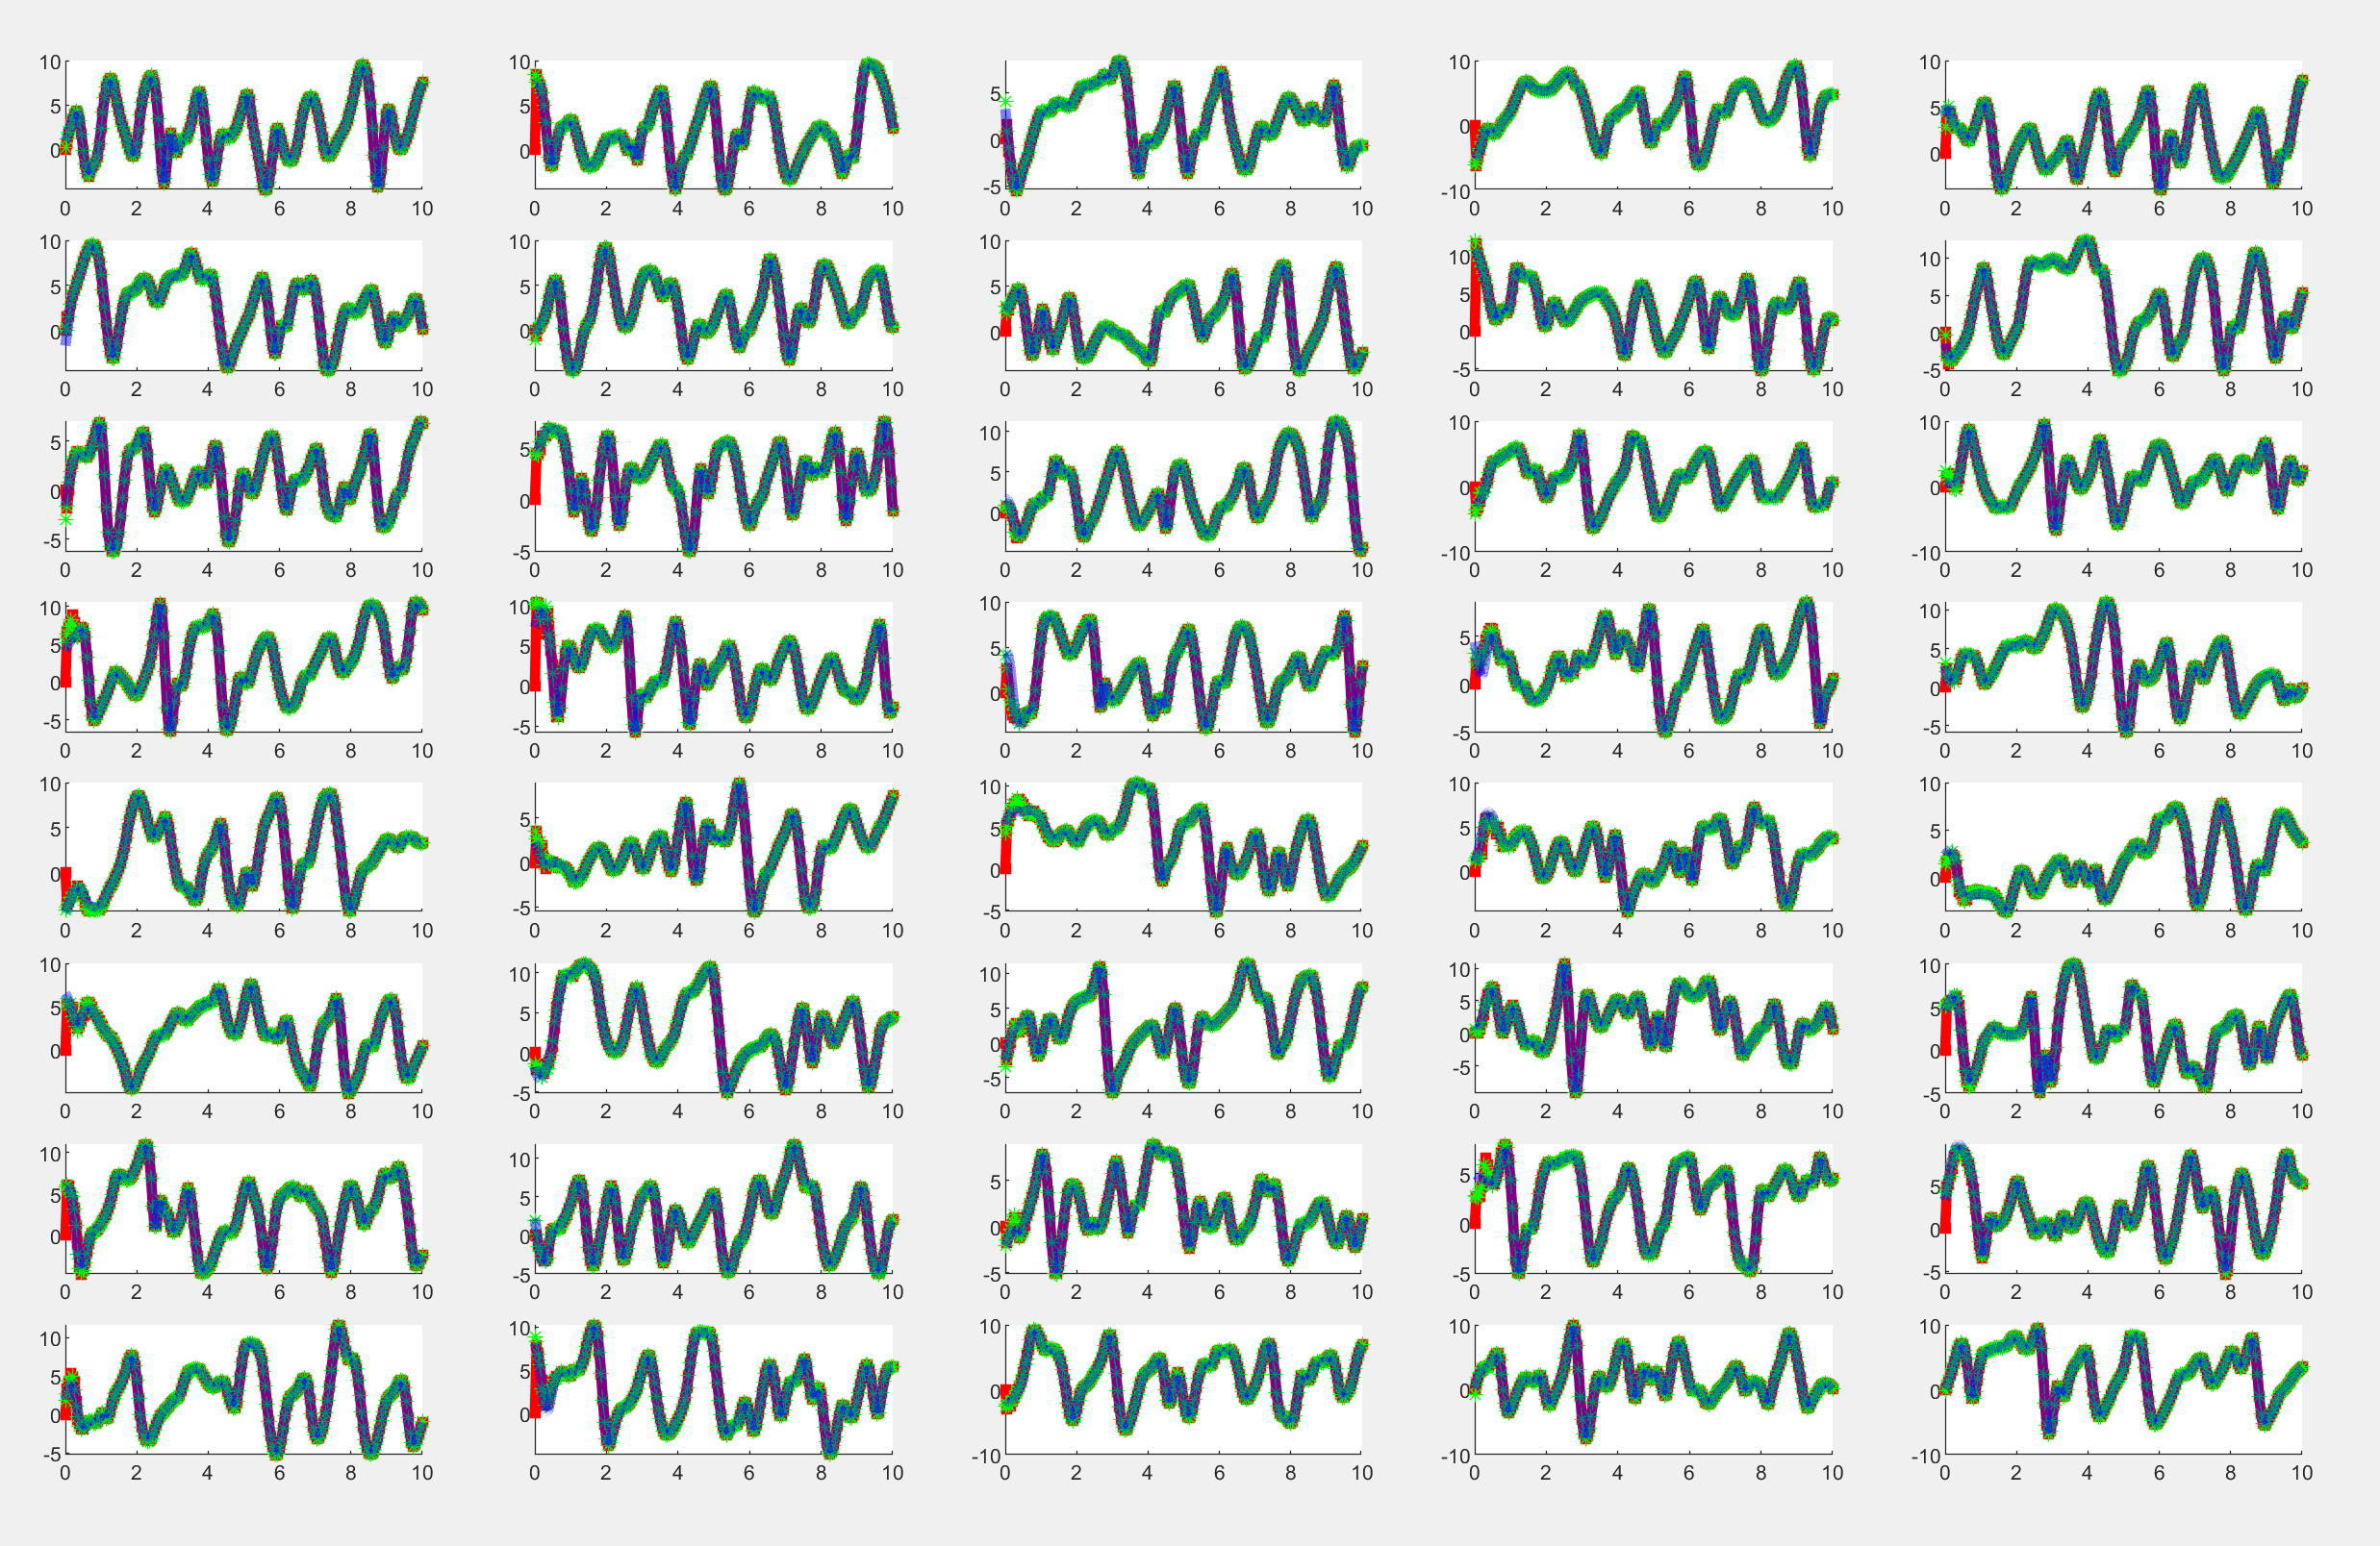
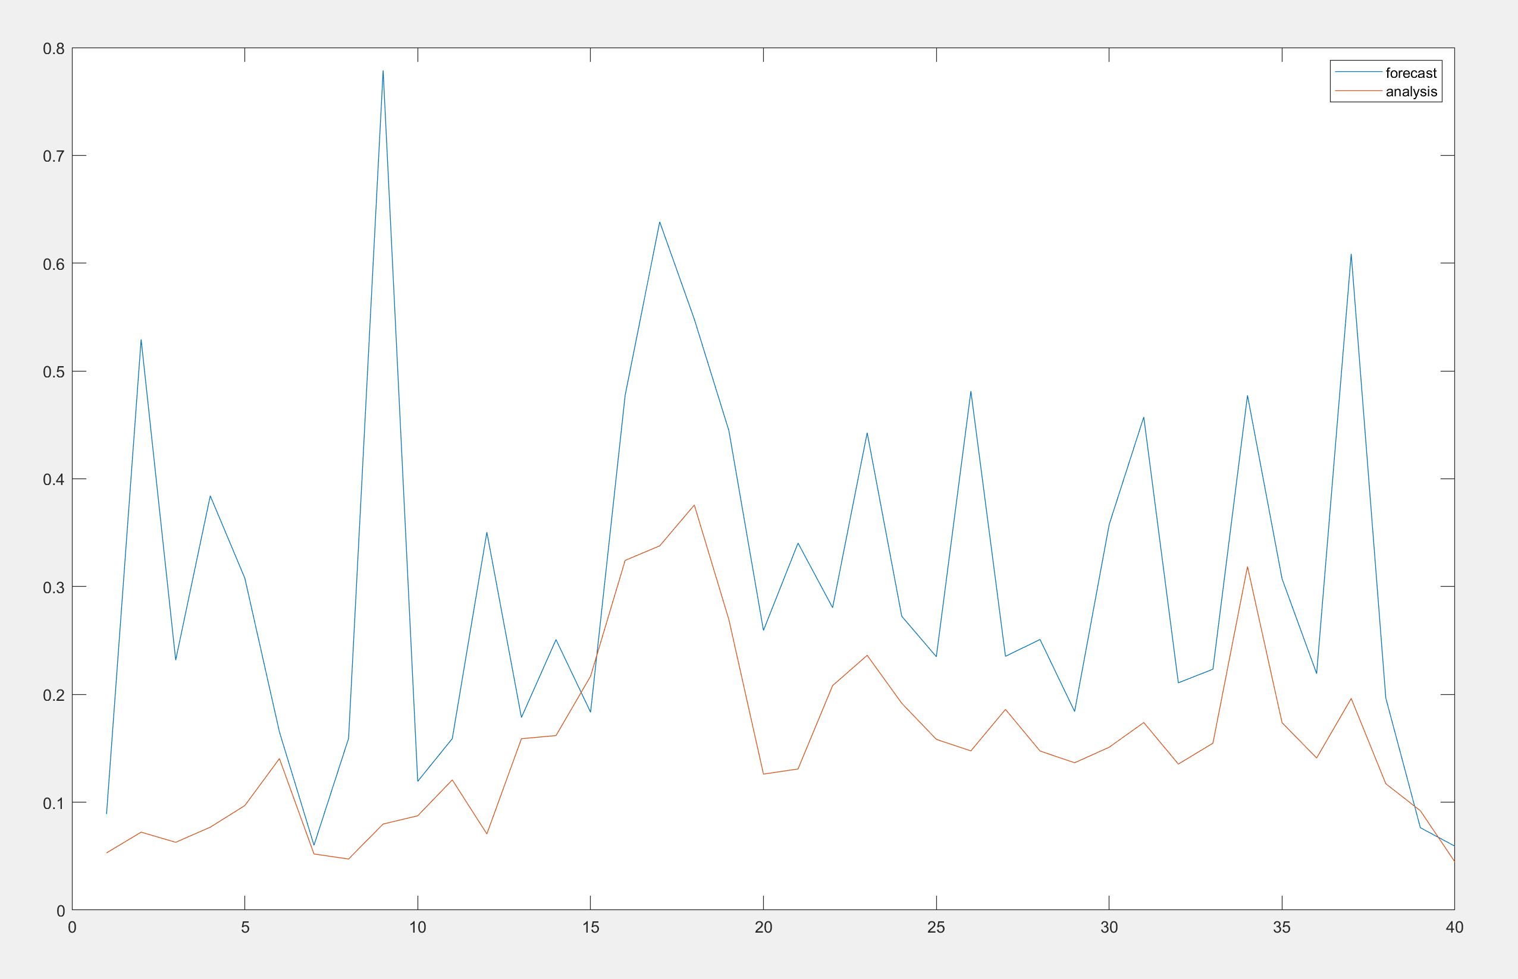
Lorenz 96 with machine learned observation operator using all 40 inputs

Slide 16
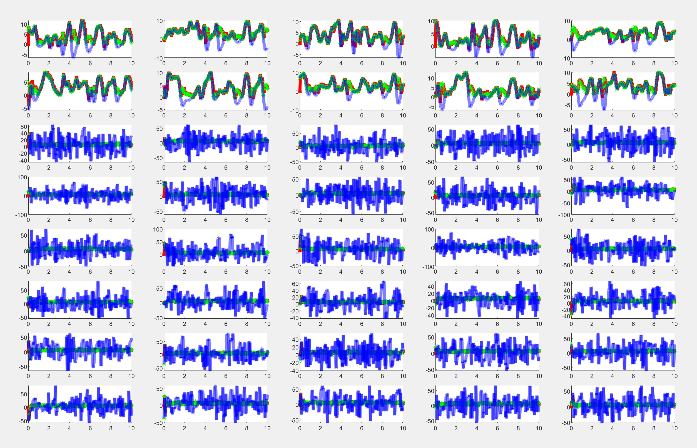
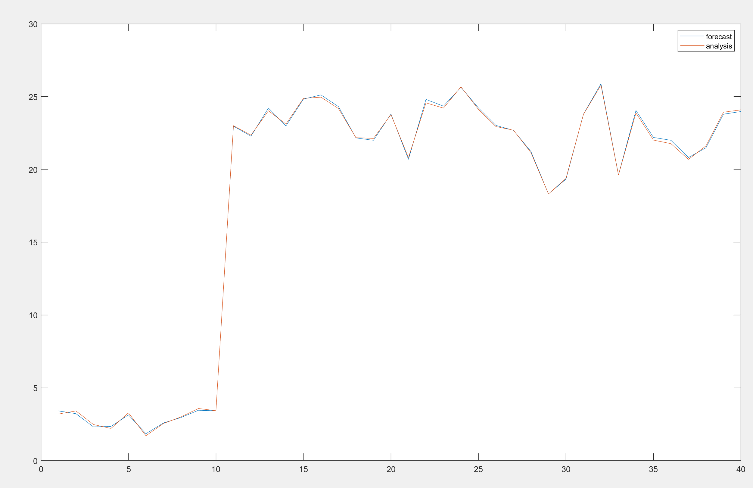
Independent systems using inverted state space

Slide 17
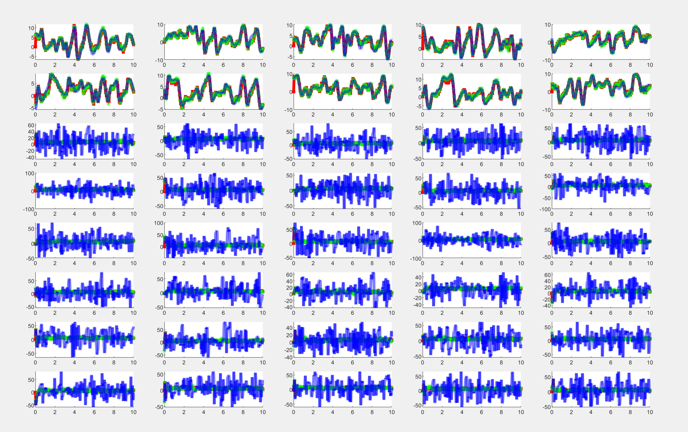
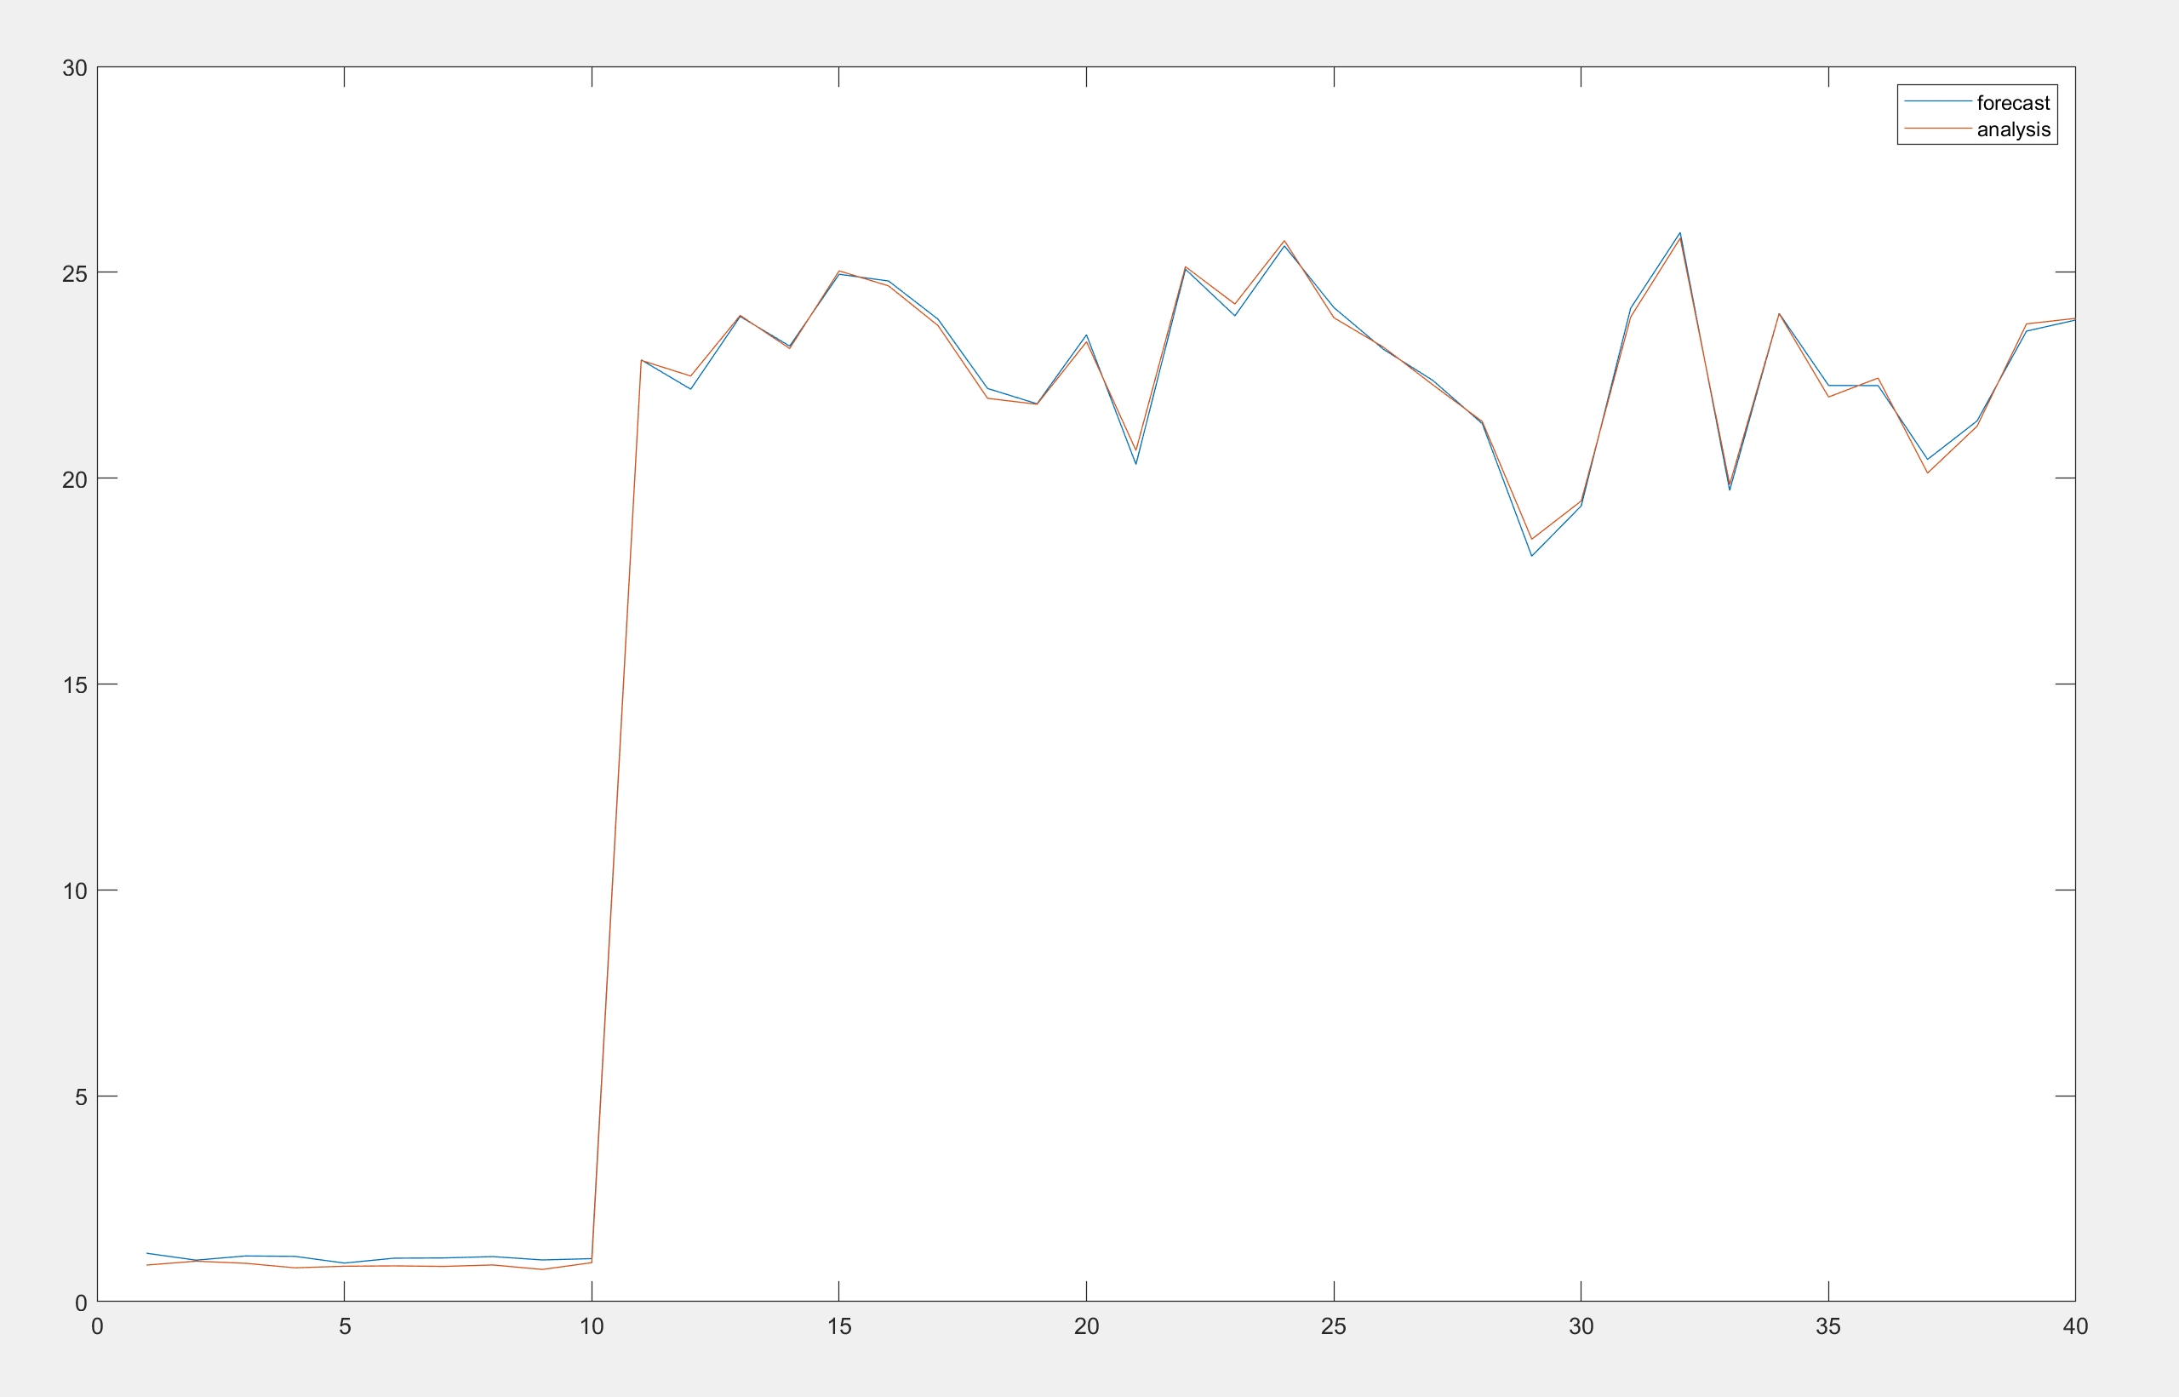
Independent systems using the known observation operator

Slide 18
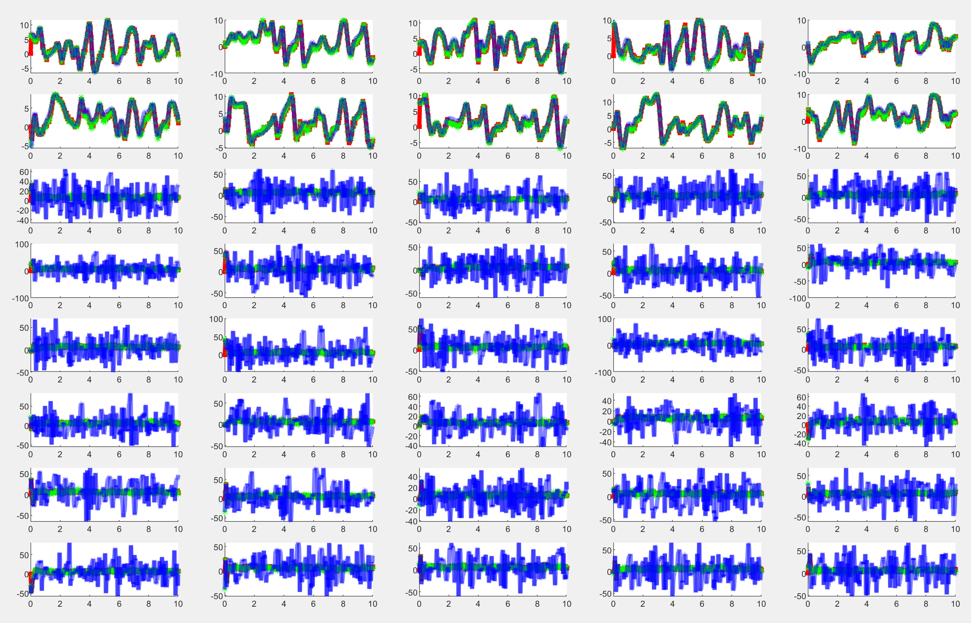
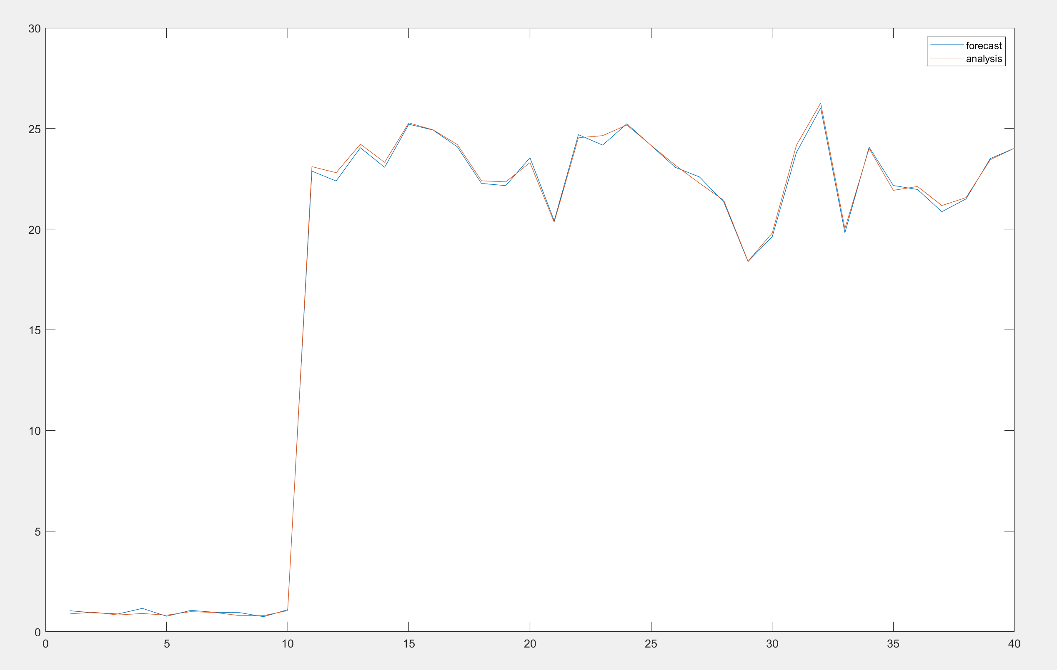
Independent systems using the machine learned observation operator on all 40 variables

Slide 19
Future work
We have been using simple neural networks and need to investigate other methods
We need to investigate other DA schemes and understand the possible challenges using functions which come from machine learning
We need to gather a training data set specific for sea ice and get acquainted with a numerical model for sea ice

Slide 20


Thank You MCRN, AIM

